Slide 1
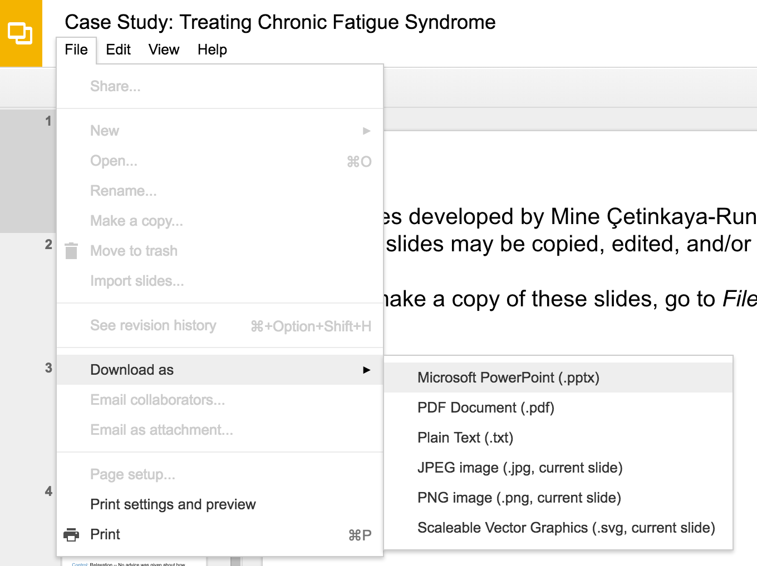
Slides developed by Mine Çetinkaya-Rundel of OpenIntro
Translated from LaTeX to Google Slides by Curry W. Hilton of OpenIntro.
The slides may be copied, edited, and/or shared via the CC BY-SA license
To make a copy of these slides, go to File > Download as > [option], as shown below. Or if you are logged into a Google account, you can choose Make a copy... to create your own version in Google Drive.

Slide 2
Random Variables

Slide 3
Random variables
A random variable is a numeric quantity whose value depends on the outcome of a random event
We use a capital letter, like X, to denote a random variable
The values of a random variable are denoted with a lowercase letter, in this case x
For example, P(X = x)
There are two types of random variables:
Discrete random variables often take only integer values
Example: Number of credit hours, Difference in number of credit hours this term vs last
Continuous random variables take real (decimal) values
Example: Cost of books this term, Difference in cost of books this term vs last

Slide 4
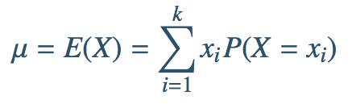
Expectation
We are often interested in the average outcome of a random variable.
We call this the expected value (mean), and it is a weighted average of the possible outcomes

Slide 5
Expected value
of a discrete random variable
In a game of cards you win $1 if you draw a heart, $5 if you draw an ace (including the ace of hearts), $10 if you draw the king of spades and nothing for any other card you draw. Write the probability model for your winnings, and calculate your expected winning.

Slide 6
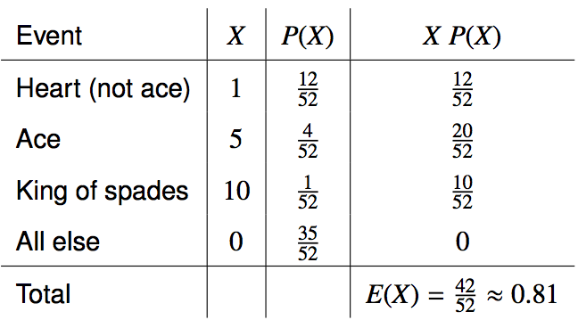
Expected value
of a discrete random variable
In a game of cards you win $1 if you draw a heart, $5 if you draw an ace (including the ace of hearts), $10 if you draw the king of spades and nothing for any other card you draw. Write the probability model for your winnings, and calculate your expected winning.

Slide 7
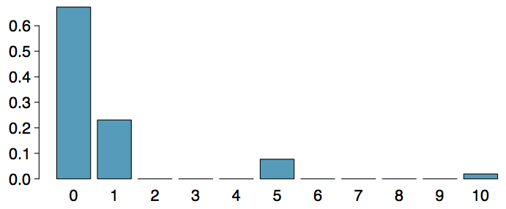
Expected value
of a discrete random variable (cont.)
Below is a visual representation of the probability distribution of winnings from this game:

Slide 8
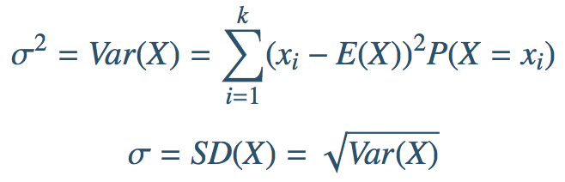
Variability
We are also often interested in the variability in the values of a random variable.

Slide 9
Variability of
a discrete random variable
For the previous card game example, how much would you expect the winnings to vary from game to game?

Slide 10
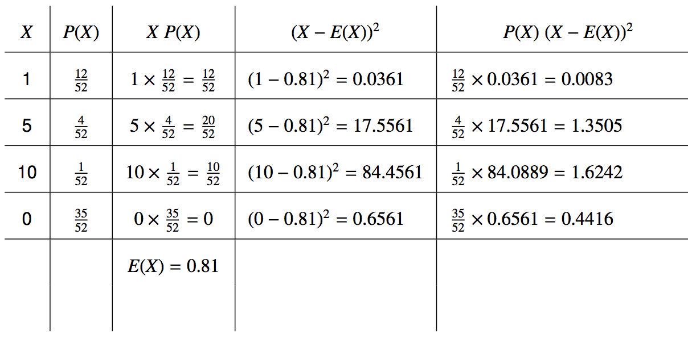
Variability of
a discrete random variable
For the previous card game example, how much would you expect the winnings to vary from game to game?

Slide 11


Variability of
a discrete random variable
For the previous card game example, how much would you expect the winnings to vary from game to game?

Slide 12
Linear combinations
A linear combination of random variables X and Y is given by
aX + bY
where a and b are some fixed numbers.

Slide 13
Linear combinations
A linear combination of random variables X and Y is given by
aX + bY
where a and b are some fixed numbers.
The average value of a linear combination of random variables is given by
E(aX + bY) = a x E(X) + b x E(Y)

Slide 14
Calculating the expectation
of a linear combination
On average you take 10 minutes for each statistics homework problem and 15 minutes for each chemistry homework problem. This week you have 5 statistics and 4 chemistry homework problems assigned. What is the total time you expect to spend on statistics and physics homework for the week?

Slide 15
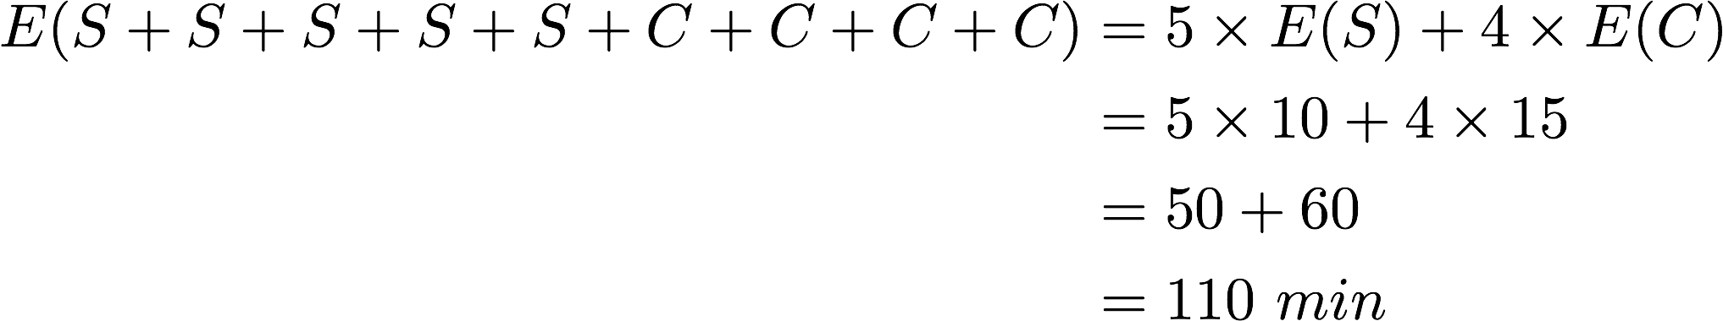
Calculating the expectation
of a linear combination
On average you take 10 minutes for each statistics homework problem and 15 minutes for each chemistry homework problem. This week you have 5 statistics and 4 chemistry homework problems assigned. What is the total time you expect to spend on statistics and physics homework for the week?

Slide 16
Linear Combination
The variability of a linear combination of two independent random variables is calculated as:

Slide 17
Linear Combination
The variability of a linear combination of two independent random variables is calculated as:
The standard deviation of the linear combination is the square root of the variance.
Note: If the random variables are not independent, the variance calculation gets a little more complicated and is beyond the scope of this course.

Slide 18
Linear combinations
The standard deviation of the time you take for each statistics homework problem is 1.5 minutes, and it is 2 minutes for each chemistry problem. What is the standard deviation of the time you expect to spend on statistics and chemistry homework for the week if you have 5 statistics and 4 chemistry homework problems assigned?

Slide 19
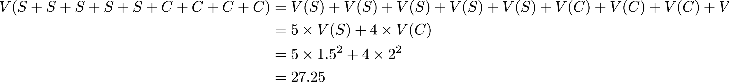
Linear combinations
The standard deviation of the time you take for each statistics homework problem is 1.5 minutes, and it is 2 minutes for each chemistry problem. What is the standard deviation of the time you expect to spend on statistics and chemistry homework for the week if you have 5 statistics and 4 chemistry homework problems assigned?
Looking for a complete explanation? There's a discussion in the OpenIntro Forums with a detailed explanation for why we aren't squaring the 5 and 4 in the equation above. [link]

Slide 20
Practice
A casino game costs $5 to play. If you draw first a red card, then you get to draw a second card. If the second card is the ace of hearts, you win $500. If not, you don't win anything, i.e. lose your $5. What is your expected profits (or losses) from playing this game? Remember: profit (or loss) = winnings - cost.
(a) a loss of 10¢ (c) a loss of 30¢
(b) a loss of 25¢ (d) a profit of 5¢

Slide 21
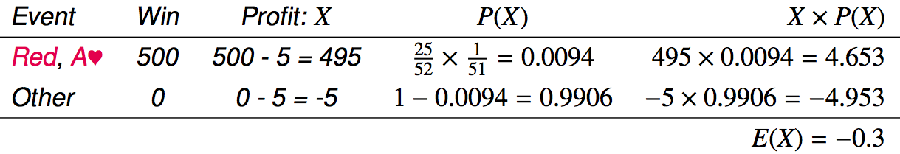
Practice
A casino game costs $5 to play. If you draw first a red card, then you get to draw a second card. If the second card is the ace of hearts, you win $500. If not, you don't win anything, i.e. lose your $5. What is your expected profits (or losses) from playing this game? Remember: profit (or loss) = winnings - cost.
(a) a loss of 10¢ (c) a loss of 30¢
(b) a loss of 25¢ (d) a profit of 5¢

Slide 22
Fair game
A fair game is defined as a game that costs as much as its expected payout, i.e. expected profit is 0.

Slide 23
Fair game
A fair game is defined as a game that costs as much as its expected payout, i.e. expected profit is 0.
Do you think casino games in Vegas cost more or less than their expected payouts?

Slide 24
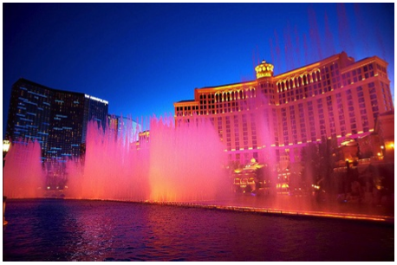
Fair game
A fair game is defined as a game that costs as much as its expected payout, i.e. expected profit is 0.
Do you think casino games in Vegas cost more or less than their expected payouts?
If those games cost less than their expected payouts, it would mean that the casinos would be losing money on average, and hence they wouldn't be able to pay for all this:
Image by Moyan_Brenn on Flickr http://www.flickr.com/photos/aigle_dore/5951714693

Slide 25
Simplifying random variables
Random variables do not work like normal algebraic variables:
X + X ≠ 2X

Slide 26
Simplifying random variables
Random variables do not work like normal algebraic variables:
X + X ≠ 2X
E(X + X) = E(X) + E(X) V(X + X) = Var(X) + Var(X)
= 2E(X) = 2 Var(X)
E(2X) = 2E(X) Var(2X) = 2² Var(X)
= 4 Var(X)
Assuming Independence

Slide 27
Simplifying random variables
Random variables do not work like normal algebraic variables:
X + X ≠ 2X
E(X + X) = E(X) + E(X) V(X + X) = Var(X) + Var(X)
= 2E(X) = 2 Var(X)
E(2X) = 2E(X) Var(2X) = 2² Var(X)
= 4 Var(X)
Assuming Independence
E(X + X) = E(2X), but Var(X + X) ≠ Var(2X)

Slide 28
Adding or multiplying?
A company has 5 Lincoln Town Cars in its fleet. Historical data show that annual maintenance cost for each car is on average $2,154 with a standard deviation of $132. What is the mean and the standard deviation of the total annual maintenance cost for this fleet?

Slide 29
Adding or multiplying?
A company has 5 Lincoln Town Cars in its fleet. Historical data show that annual maintenance cost for each car is on average $2,154 with a standard deviation of $132. What is the mean and the standard deviation of the total annual maintenance cost for this fleet?
Note that we have 5 cars each with the given annual maintenance cost (X1 + X2 + X3 + X4 + X5), not one car that had 5 times the given annual maintenance cost (5X).

Slide 30
Adding or multiplying?
A company has 5 Lincoln Town Cars in its fleet. Historical data show that annual maintenance cost for each car is on average $2,154 with a standard deviation of $132. What is the mean and the standard deviation of the total annual maintenance cost for this fleet?
Note that we have 5 cars each with the given annual maintenance cost (X1 + X2 + X3 + X4 + X5), not one car that had 5 times the given annual maintenance cost (5X).

Slide 31
Adding or multiplying?
A company has 5 Lincoln Town Cars in its fleet. Historical data show that annual maintenance cost for each car is on average $2,154 with a standard deviation of $132. What is the mean and the standard deviation of the total annual maintenance cost for this fleet?
Note that we have 5 cars each with the given annual maintenance cost (X1 + X2 + X3 + X4 + X5), not one car that had 5 times the given annual maintenance cost (5X).

Slide 32
Adding or multiplying?
A company has 5 Lincoln Town Cars in its fleet. Historical data show that annual maintenance cost for each car is on average $2,154 with a standard deviation of $132. What is the mean and the standard deviation of the total annual maintenance cost for this fleet?
Note that we have 5 cars each with the given annual maintenance cost (X1 + X2 + X3 + X4 + X5), not one car that had 5 times the given annual maintenance cost (5X).

Slide 33
Adding or multiplying?
A company has 5 Lincoln Town Cars in its fleet. Historical data show that annual maintenance cost for each car is on average $2,154 with a standard deviation of $132. What is the mean and the standard deviation of the total annual maintenance cost for this fleet?
Note that we have 5 cars each with the given annual maintenance cost (X1 + X2 + X3 + X4 + X5), not one car that had 5 times the given annual maintenance cost (5X).

Slide 34
Adding or multiplying?
A company has 5 Lincoln Town Cars in its fleet. Historical data show that annual maintenance cost for each car is on average $2,154 with a standard deviation of $132. What is the mean and the standard deviation of the total annual maintenance cost for this fleet?
Note that we have 5 cars each with the given annual maintenance cost (X1 + X2 + X3 + X4 + X5), not one car that had 5 times the given annual maintenance cost (5X).

Slide 35
Find more resources at openintro.org/os, including
Slides
Videos
Statistical Software Labs
Discussion Forums (free support for students and teachers)
Learning Objectives
Teachers only content is also available for Verified Teachers, including
Exercise solutions
Sample exams
Ability to request a free desk copy for a course
Statistics Teachers email group
Questions? Contact us.

